Slide 1
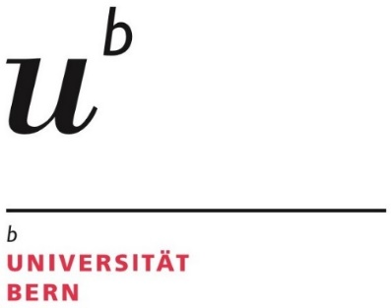
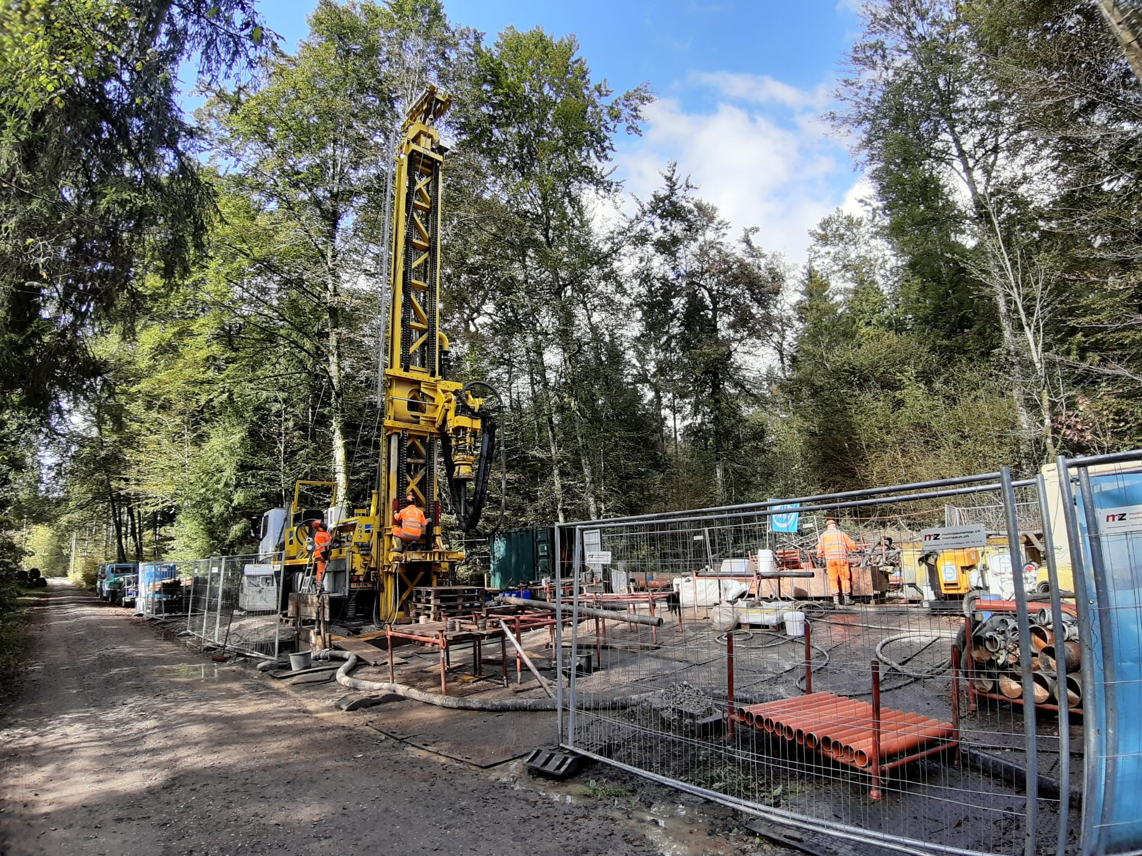


Automatic lithoclassification of unconsolidated sediments
ADS CAS Module 3
01.12.2023
Sebastian Schaller and Patricio Becerra

Slide 2
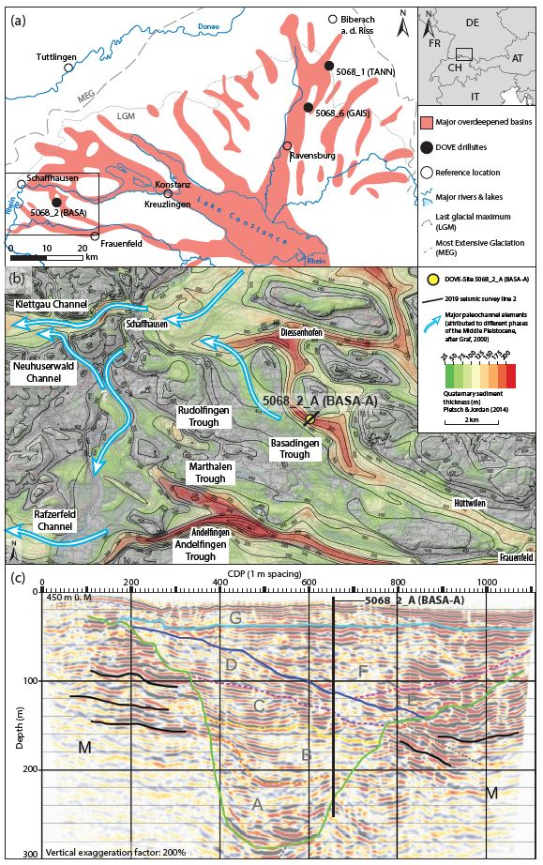
Introduction and background
Glacial extents of the Rhine Glacier
Seismic line
Local overdeepenings
Drill core

Slide 3
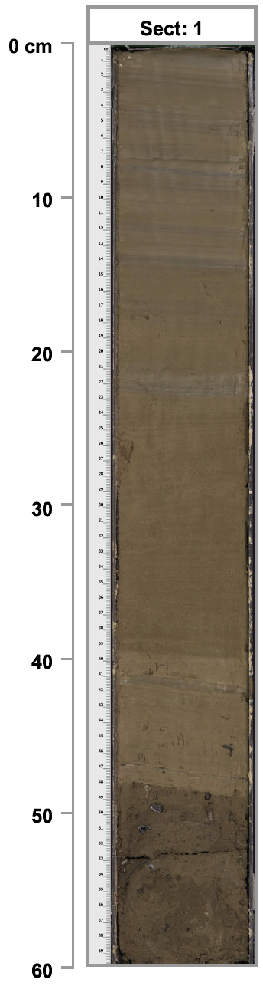
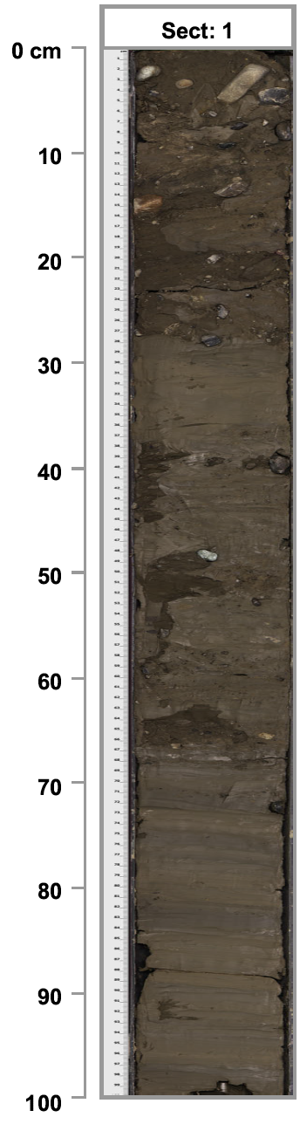
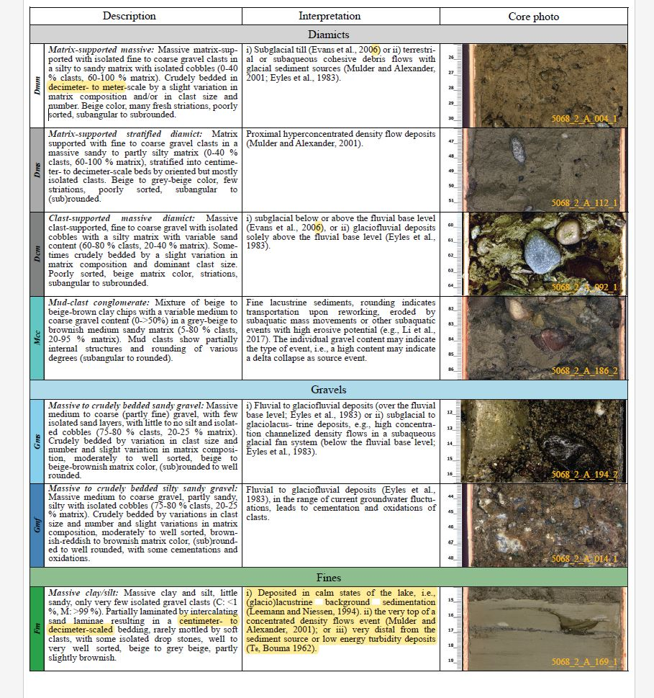
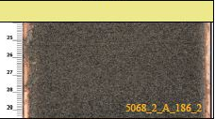
Introduction and background
Sedimentological, geophysical, and chemical logs ('features') were collected from a 252-meter-long sediment drill core.
The unconsolidated sediments in the log are classified into several lithoclastic types (e.g. sand, or fine clays)
The goal of the M3 project is to set the foundation for a machine learning model that can perform a log-based classification of unconsolidated quaternary sediments.
Advantages:
Core drilling is expensive ~1000 sFr/m
It takes a lot of time to analyze and describe → 1-2 years from drilling to a proper stratigraphic profile
A combination of much cheaper destructive drilling with wireline logging would be able to obtain the same logs.
This dataset could then be run through the ML model to reconstruct the stratigraphy
Diamict
Gravel
Sand
Fines

Slide 4
Module 3 Objectives
Visualise the data in such a way that the visually-classified clusters are distinguishable
Attempt to find patterns in the data independent of the visual classification through unsupervised clustering algorithms. Two approaches are attempted:
Direct clustering by several algorithms such as K-Means, and HDBSCAN
PCA-analysis for dimensionality reduction followed by K-Means and HDBSCAN clustering
Compare the visual-based classification of the sediments (classic geological route) with the semi-automated data-based clustering of the logs (step 2)

Slide 5
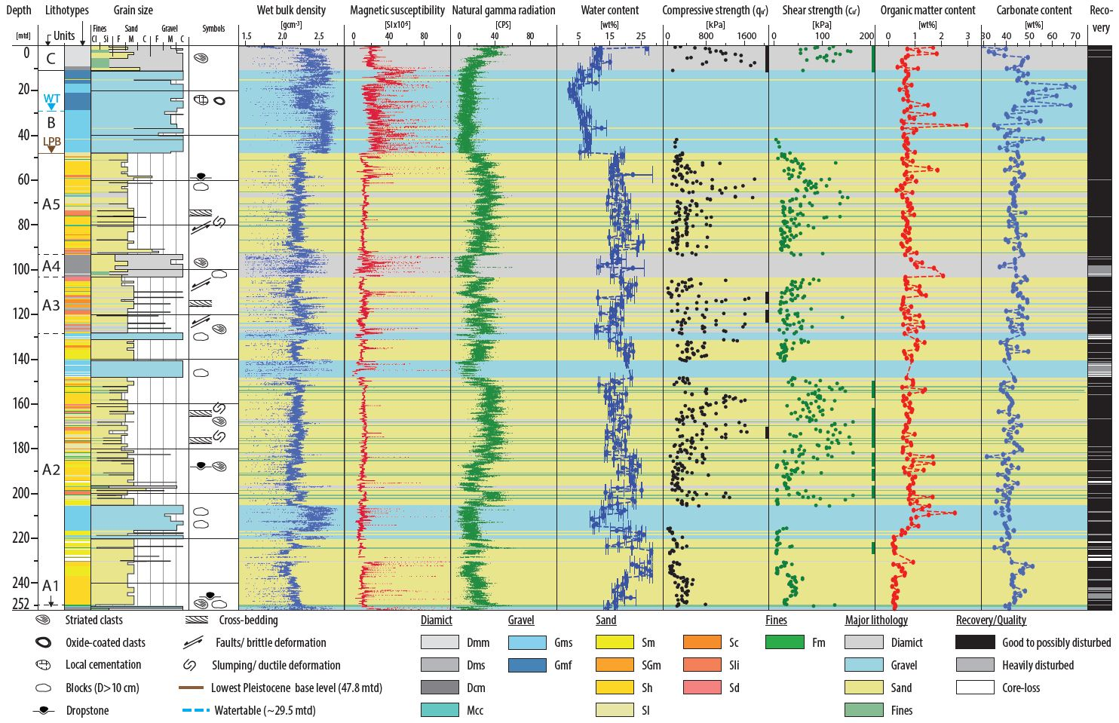
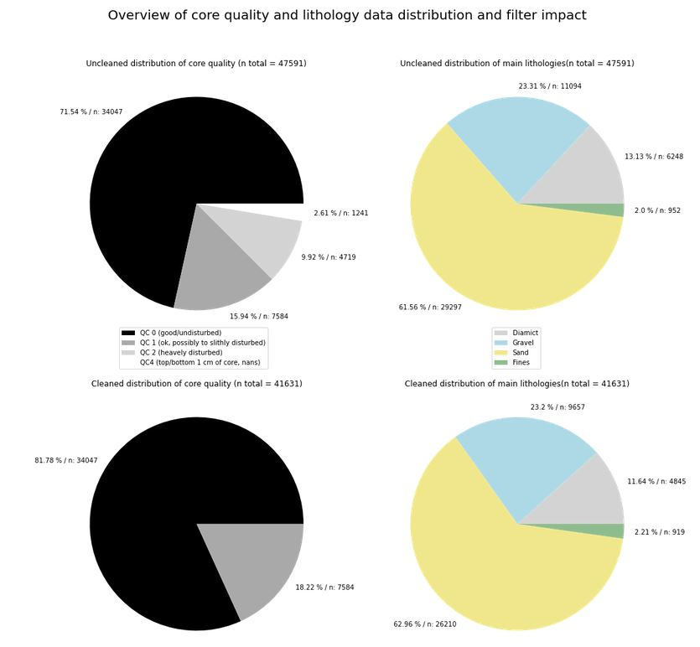
Dataset: Overview
Unfiltered
Gravel
Class 1 (undist.)
Diamict
Sand
Fines
Class 3
(heavy dist.)
Class 2
(pos. dist.)
Filtered
Gravel
Class 1 (undist.)
Diamict
Class 2
(pos. dist.)
Fines
Sand

Slide 6
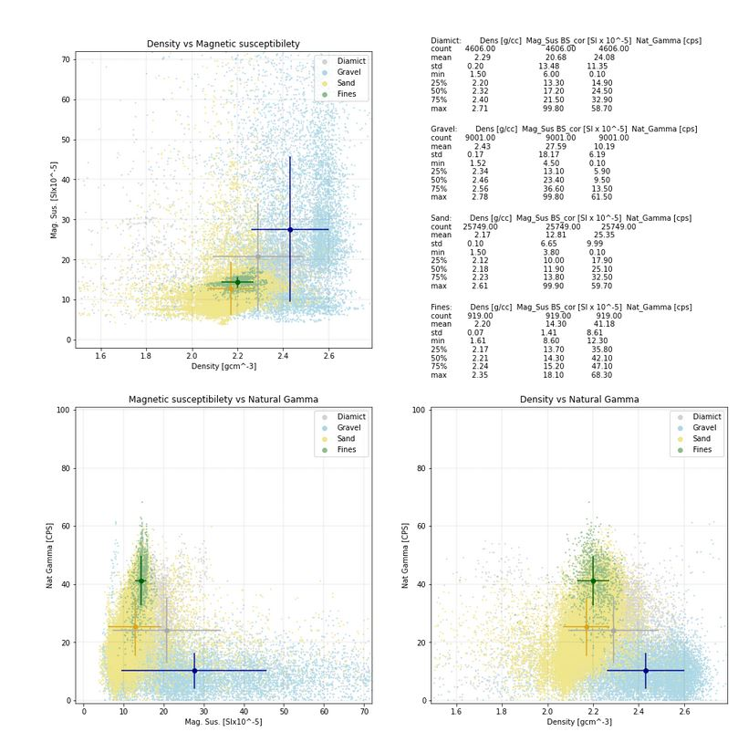
Dataset: Visual classification
 | All data | Diamict | Gravel | Sand | Fines
counts | 41464 | 4782 | 9633 | 26130 | 919
mean | 2.25 | 2.28 | 2.43 | 2.17 | 2.20
std | 0.17 | 0.20 | 0.17 | 0.10 | 0.07
min | 1.50 | 1.50 | 1.52 | 1.51 | 1.61
25% | 2.15 | 2.20 | 2.34 | 2.12 | 2.17
50% | 2.22 | 2.32 | 2.46 | 2.18 | 2.21
75% | 2.33 | 2.40 | 2.56 | 2.23 | 2.24
max | 2.78 | 2.71 | 2.78 | 2.61 | 2.35

Slide 7
Conclusions from Module 2
Logs consist clearly of not normally distributed data
Data supports the visual-based classification qualitatively ->
The scatter plots and the internal distributions (histograms) make sense in a geological/sedimentological way
Density and Natural gamma logs seem to be the dominant logs in the data set and are promising candidates for use
Magnetic susceptibility may be less useful in the current type of sediments due to several technical and geological reasons
For Module 3:
Quantitative analyses (Cluster analyses, Principal Component Analyses (PCA))
Go to Notebook

Slide 8
Conclusions and outlook from Module 3
All three logs and the depth are valuable input features to the clustering, as shown by the PCA analysis
PCA-reduced show better clustering in general when compared to the visually classified classes
The best result is obtained with PCA-reduction + HDBSCAN clustering (ARI = 0.5)
In general, the procedure shows promise → continue with model
Outlook
Further data cleaning: mean of 10 cm slices → reduction of datapoints by a factor of 20 → noise-reduction
Trying alternative options for dimension-reduction and cluster-algorithms
Searching for alternative logs/parameters and expanding the input features
If a sufficent level of accuracy is reached and visually confirmed → proof of concept established
Test on further datasets

Slide 9
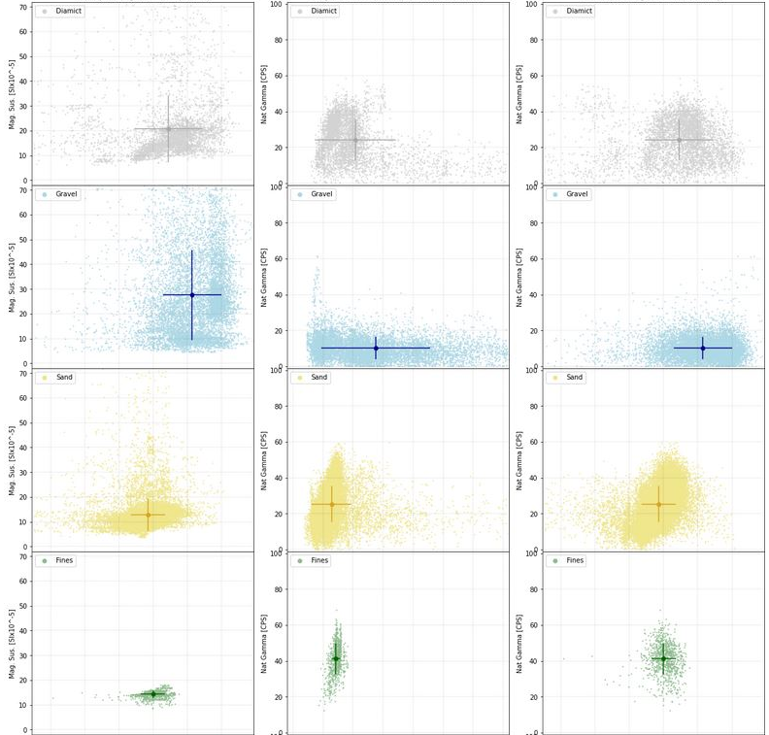
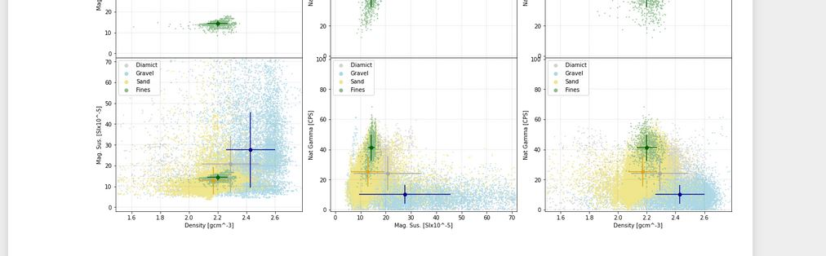
Scatter Plots Density/Magnetic Susceptibility/Natural Gamma
Diamict | Density | Mag. Sus | Natgamma
counts | 4606
mean | 2.29 | 20.68 | 24.08
std | 0.20 | 13.48 | 11.35
min | 1.50 | 6.00 | 0.10
25% | 2.20 | 13.30 | 14.90
50% | 2.32 | 17.20 | 24.50
75% | 2.40 | 21.50 | 32.90
max | 2.71 | 99.80 | 58.70
Gravel | Density | Mag. Sus | Natgamma
counts | 9001
mean | 2.43 | 27.59 | 10.19
std | 0.17 | 18.17 | 6.19
min | 1.52 | 4.50 | 0.10
25% | 2.34 | 13.10 | 5.90
50% | 2.46 | 23.40 | 9.50
75% | 2.56 | 36.60 | 13.50
max | 2.78 | 99.80 | 61.50
Sand | Density | Mag. Sus | Natgamma
counts | 25749
mean | 2.17 | 12.81 | 25.35
std | 0.10 | 6.65 | 9.99
min | 1.50 | 3.80 | 0.10
25% | 2.12 | 10.00 | 17.90
50% | 2.18 | 11.90 | 25.10
75% | 2.23 | 13.80 | 32.50
max | 2.61 | 99.90 | 59.70
Fines | Density | Mag. Sus | Natgamma
counts | 919
mean | 2.20 | 14.30 | 41.18
std | 0.07 | 1.41 | 8.61
min | 1.61 | 8.60 | 12.30
25% | 2.17 | 13.70 | 35.80
50% | 2.21 | 14.30 | 42.10
75% | 2.24 | 15.20 | 47.10
max | 2.35 | 18.10 | 68.30
Dens./Mag.Sus
Mag.Sus/Nat.Gamma
Dens./Nat.Gamma

Slide 10
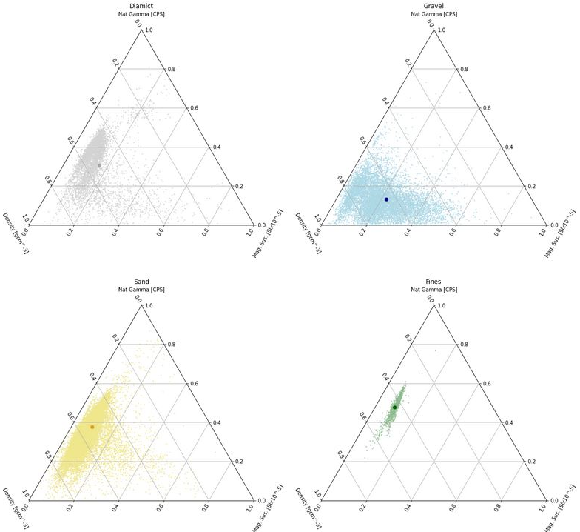
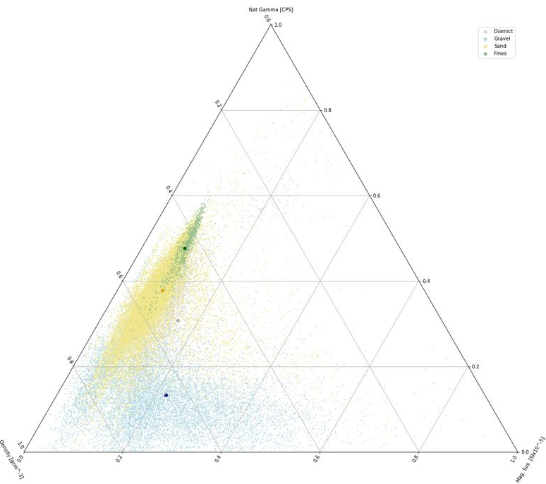
Ternary Scatter Plots Density/Magnetic Susceptibility/Natural Gamma
Density <->Natural Gamma, dominant logs?
Nat Gamma
Two clusters?
Impact of magnetic on gravel?
Density
Mag. Sus.

